Slide 1
Burning man
Burning Man is an annual week-long experiment in temporary community

Slide 2
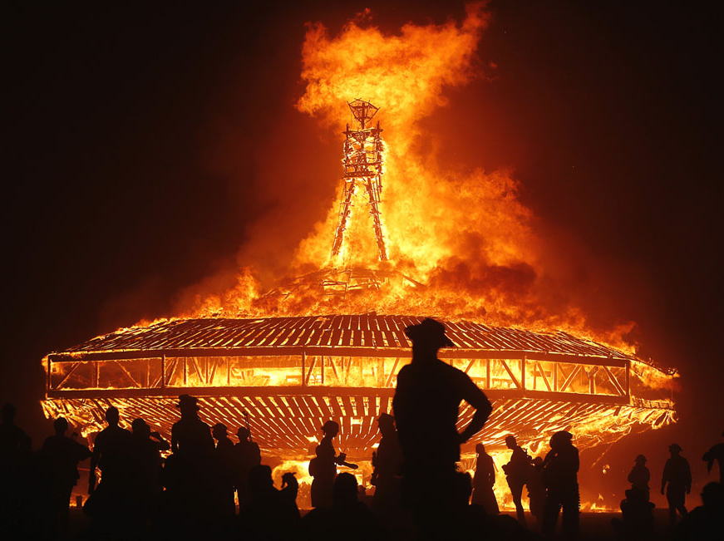
Modern “Burning man”
the Burning Man art festival, which attracted more than 35,000 participants in 2005, traditionally culminates with the burning of a large wooden sculpture of a man.

Slide 3
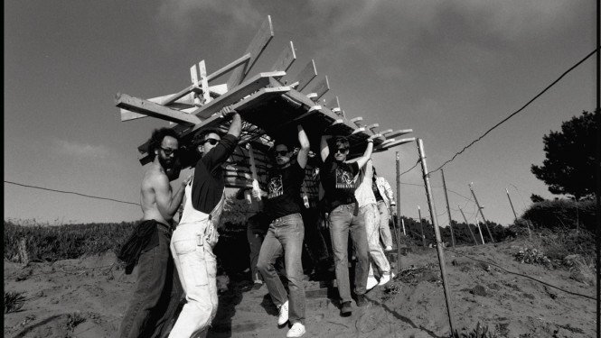
How is “Burning Man” celebrated before and now?
1986
Now

Slide 4
History of the “Burning man”
Burning Man was founded in 1986 when San Francisco artist Larry Harvey gathered a small group of people on the Summer Solstice to burn an 8-foot wooden structure of a man at Baker Beach

Slide 5
How is “Burning Man” celebrated

